Slide 1
HEPATITIS C PREDICTION
NAME : ENUGALA HARSHITHA
ROLL . NO : 2203A52210

Slide 2
INTRODUCTION:
What is Hepatitis C ?
Hepatitis C is a viral infection that causes liver swelling, called inflammation. Hepatitis C can lead to serious liver damage. The hepatitis C virus (HCV) spreads through contact with blood that has the virus in it.
Newer antiviral medicines are the treatment of choice for most people with the ongoing, called chronic, hepatitis C infection. These medicines often can cure chronic hepatitis C. But many people with hepatitis C don't know they have it. That's mainly because symptoms can take decades to appear. So, the U.S. Preventive Services Task Force recommends that all adults ages 18 to 79 years be screened for hepatitis C.
Screening is for everyone, even those who don't have symptoms or known liver disease.

Slide 3
CAUSES OF HEPATITIS C:
Hepatitis C infection is caused by the hepatitis C virus (HCV). The infection spreads when blood that has the virus enters the bloodstream of a person who isn't affected.
Around the world, hepatitis C infection exists in several forms, called genotypes. There are seven genotypes and 67 subtypes. The most common hepatitis C genotype in the United States is type 1.
Chronic hepatitis C follows the same course no matter what the genotype of the infecting virus. But treatment can vary depending on viral genotype. However, newer antiviral drugs can treat many genotypes.

Slide 4
SYMPTOMS:
Every long-term hepatitis C infection starts with what's called an acute phase. Acute hepatitis C usually isn't diagnosed because it rarely causes symptoms. When there are symptoms in this phase, they may include jaundice, fatigue, nausea, fever and muscle aches.
Long-term infection with the hepatitis C virus is called chronic hepatitis C. Chronic hepatitis C usually has no symptoms for many years. Symptoms appear only after the virus damages the liver enough to cause them.
Acute hepatitis C infection doesn't always become chronic. Some people clear the infection from their bodies after the acute phase. This is called spontaneous viral clearance. Antiviral therapy also helps clear acute hepatitis C.

Slide 5
DATASET EXPLANATION:
The data set contains laboratory values of blood donors and Hepatitis C patients and demographic values like age.
All attributes except Category and Sex are numerical.
X (Patient ID/No.)
Category (diagnosis) (values: '0=Blood Donor', '0s=suspect Blood Donor', '1=Hepatitis', '2=Fibrosis', '3=Cirrhosis’)
Age (in years)
Sex (female , male)
ALB
ALP
ALT
AST
BIL
CHE
CHOL
CREA
GGT
PROT

Slide 6
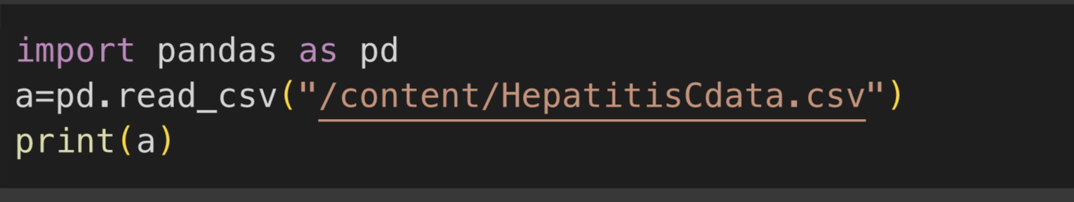
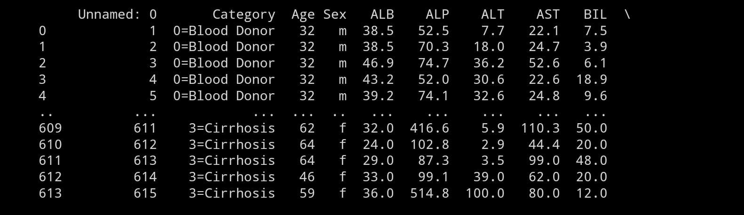
DATASET CODE :

Slide 7
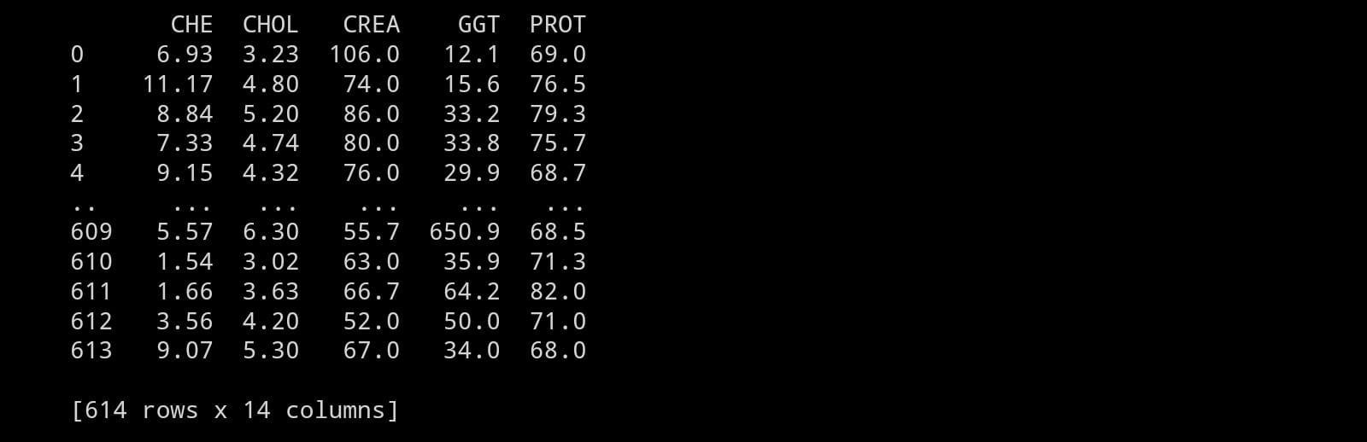

Slide 8
FEATURES AND TARGET VARIABLE:
Here the dataset is loaded using pandas library.
We can see that the dataset have features and a target variable.
Features : Unnamed , Age , Sex , ALB , ALP , ALT , AST , BIL , CHE , CHOL , CREA , GGT , PROT
Target Variable : Category
From the dataset we can see that it is parametric method approach.
The dataset contains categorical values.
So , this is classification.

Slide 9
IMPLEMENTATION:
There are three methods to find the accuracy for the classification dataset.
They are:
Logistic Regression
Support Vector Machine
Perception Learning
K-Nearest Neighbour
PCA
Boot strapping

Slide 10
LOGISTIC REGRESSION:
Logistic regression is a classification algorithm, used when the value of the target variable is categorical in nature. It follows parametric method approach . It can be applied for supervised data. Logistic regression is most commonly used when the data in question has binary output, so when it belongs to one class or another, or is either a 0 or 1.
Mathematically, a logistic regression model predicts P(Y=1) as a function of X.
It is one of the simplest ML algorithms that can be used for various classification problems .

Slide 11
SUPPORT VECTOR MACHINE:
Support Vector Machine (SVM) is a powerful and versatile machine learning algorithm primarily used for classification and regression tasks. It's particularly well-suited for both linear and nonlinear classification problems and is known for its ability to find an optimal hyperplane or decision boundary that maximizes the margin between different classes. Here are the key concepts and characteristics of SVM:
Hyperplane : In SVM, the goal in classification is to find a hyperplane that best separates the data points of different classes. This hyperplane is chosen to maximize the margin, which is the distance between the hyperplane and the nearest data points (support vectors) of each class.

Slide 12
Support vectors: Support vectors are the data points that are closest to the hyperplane and have the smallest margin. They play a critical role in defining the position and orientation of the hyperplane.
Linear and Nonlinear Separation: SVM is effective for linearly separable data, where a straight line (or hyperplane in higher dimensions) can separate the classes. However, SVM can also handle nonlinear data by using techniques like the kernel trick. Kernels allow SVM to transform the original feature space into a higher-dimensional space, where the data becomes linearly separable.

Slide 13
Classification and Regression: SVM is primarily used for classification, where it assigns data points to different classes. However, it can also be used for regression tasks, referred to as Support Vector Regression (SVR), where it finds a hyperplane that best fits the data while minimizing errors.
SVMs are widely used in applications like image classification, text classification, bioinformatics, and many others. They are favored for their ability to handle high-dimensional data, robustness against overfitting, and adaptability to both linear and nonlinear problems. However, tuning SVM hyperparameters, especially for non-linear kernels, can be a complex task.

Slide 14
PERCEPTRON LEARNING:
Perceptron is a building block of an Artificial Neural Network.
Perceptron is a linear Machine Learning algorithm used for supervised learning for various binary classifiers.
This algorithm enables neurons to learn elements and processes them one by one during preparation.
The perceptron consists of 4 parts.
•Input values or One input layer
Weights and Bias
Net sum
Activation function

Slide 15
Activation Function: A neuron can be activated or not, is determined by an activation function. The activation function calculates a weighted sum and further adding bias with it to give the result.
The default activation function in perception learning is
Sigmoid function.

Slide 16
K-Nearest Neighbour:
The k-nearest neighbors (k-NN) algorithm is a simple and effective supervised machine learning algorithm used for classification and regression tasks. It's a non-parametric method that doesn't make any underlying assumptions about the distribution of the data.
Distance Calculation: For a given data point to be classified, k-NN calculates the distance between that point and all other points in the dataset. Euclidean distance is a common measure, but other distance metrics like Manhattan or cosine distance can also be used, depending on the nature of the data.
Choosing the Neighbors: The algorithm then selects the k-nearest data points (neighbors) based on the calculated distances.

Slide 17
Majority Vote (for Classification): For classification tasks, the most common class label among the k-nearest neighbors is assigned to the data point being classified. This is determined through a majority vote.
Average (for Regression): For regression tasks, the average of the values of the k-nearest neighbors is taken and used as the predicted value for the data point.
K:It represents the number of neighbors to consider. The choice of 'k' can significantly impact the performance of the algorithm. A lower 'k' value leads to a more complex model and can result in overfitting, while a higher 'k' value may lead to oversimplification.
It's important to preprocess the data, perform feature scaling, and choose suitable 'k' and distance metrics to get the best performance from the k-NN algorithm.

Slide 18
Principal Component Analysis (PCA):
Principal Component Analysis (PCA) is a dimensionality reduction technique used in data analysis and machine learning to simplify the complexity of high-dimensional datasets. It identifies patterns in data, aiming to reduce its dimensionality while preserving important information.
Correlation and Variance Analysis: PCA analyzes the correlations between features in a dataset. It seeks directions, called principal components, along which the variance of the data is maximized.
Dimension Reduction: PCA transforms the original features into a new set of orthogonal (uncorrelated) features called principal components. These components are ordered by the amount of variance they explain in the data.
Selection of Principal Components: The number of principal components selected is usually determined based on the variance explained or by specifying the desired amount of variance to retain in the data.

Slide 19
PCA is a powerful technique in exploratory data analysis and feature extraction, especially in situations where the original data has high dimensionality and computational complexity. It helps in understanding the underlying structure of the data by capturing the most critical aspects while reducing its dimensionality.

Slide 20
Boot strapping:
A statistical resampling technique used to estimate the sampling distribution of a statistic. Bootstrapping involves creating multiple datasets (known as bootstrap samples) by sampling with replacement from the original dataset. This method is widely used in statistics and machine learning to derive estimates and assess the uncertainty of a statistic or a machine learning model.
Resampling with Replacement: Bootstrapping involves drawing samples of the same size as the original dataset from the dataset itself, with replacement. Each bootstrap sample is randomly selected, allowing instances to be included more than once.
Estimation: After creating multiple bootstrap samples, a statistic or machine learning model is applied to each of these samples to calculate an estimate (mean, standard deviation, confidence intervals, regression coefficients, etc.).

Slide 21
Aggregation of Results: The resulting estimates obtained from the multiple samples are aggregated, often by averaging or combining to create a single overall estimate. This provides an understanding of the variability and uncertainty associated with the statistic or model.
Bootstrapping is a powerful tool used in various fields for statistical inference, model validation, and parameter estimation. It allows practitioners to derive estimates and understand the uncertainty associated with those estimates without making strong assumptions about the underlying data distribution.

Slide 22
LIBRARIES USED:
PANDAS: to load the dataset
MATPLOTLIB.PYPLOT : to implement graphs
SKLEARN.MODEL_SELECECTION : for test and train split
SKLEARN.SVM : for logistic regression in classification
SKLEARN.METRICS:
Accuracy score
Classification report
Confusion matrix
SKLEARN : SVM
SKLEARN.LINEAR MODEL : Perceptron learning

Slide 23
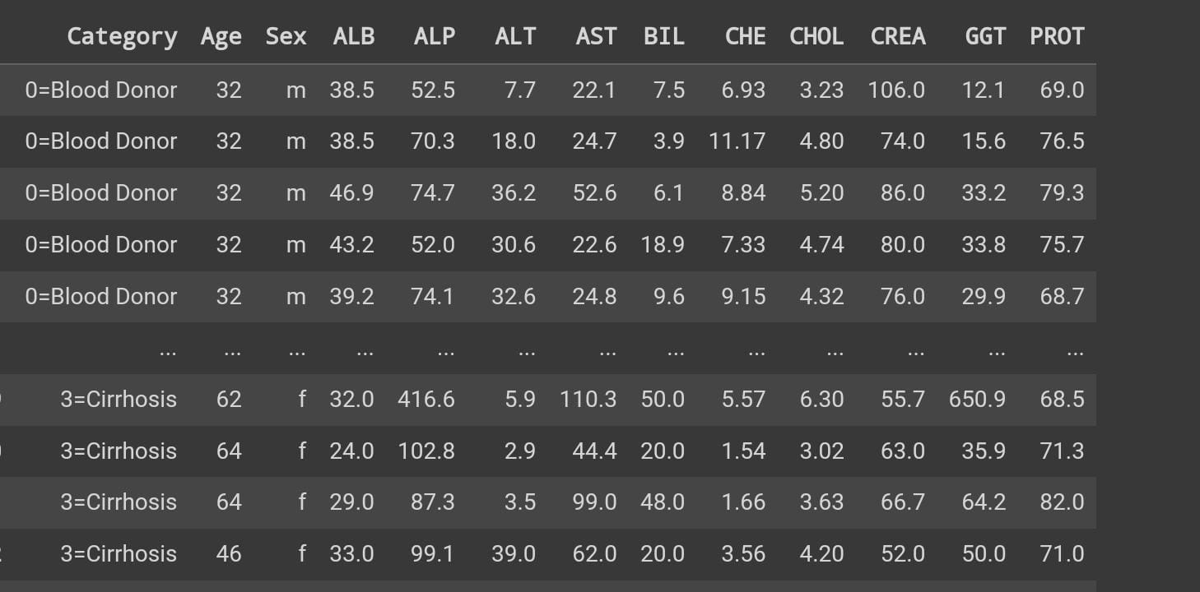

Slide 24
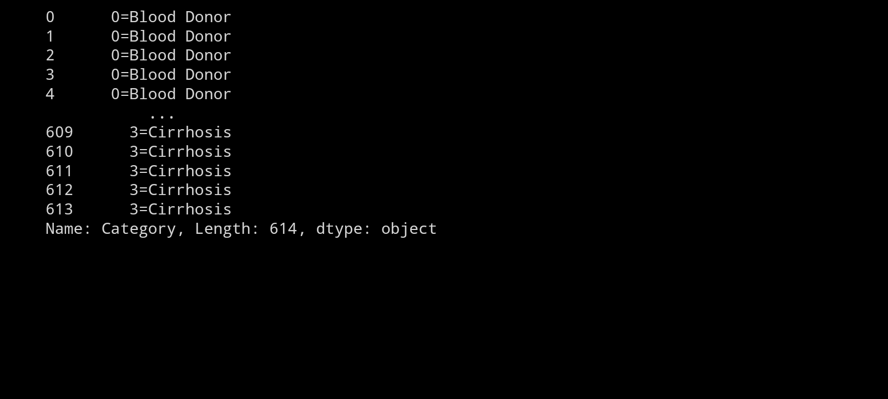

Slide 25
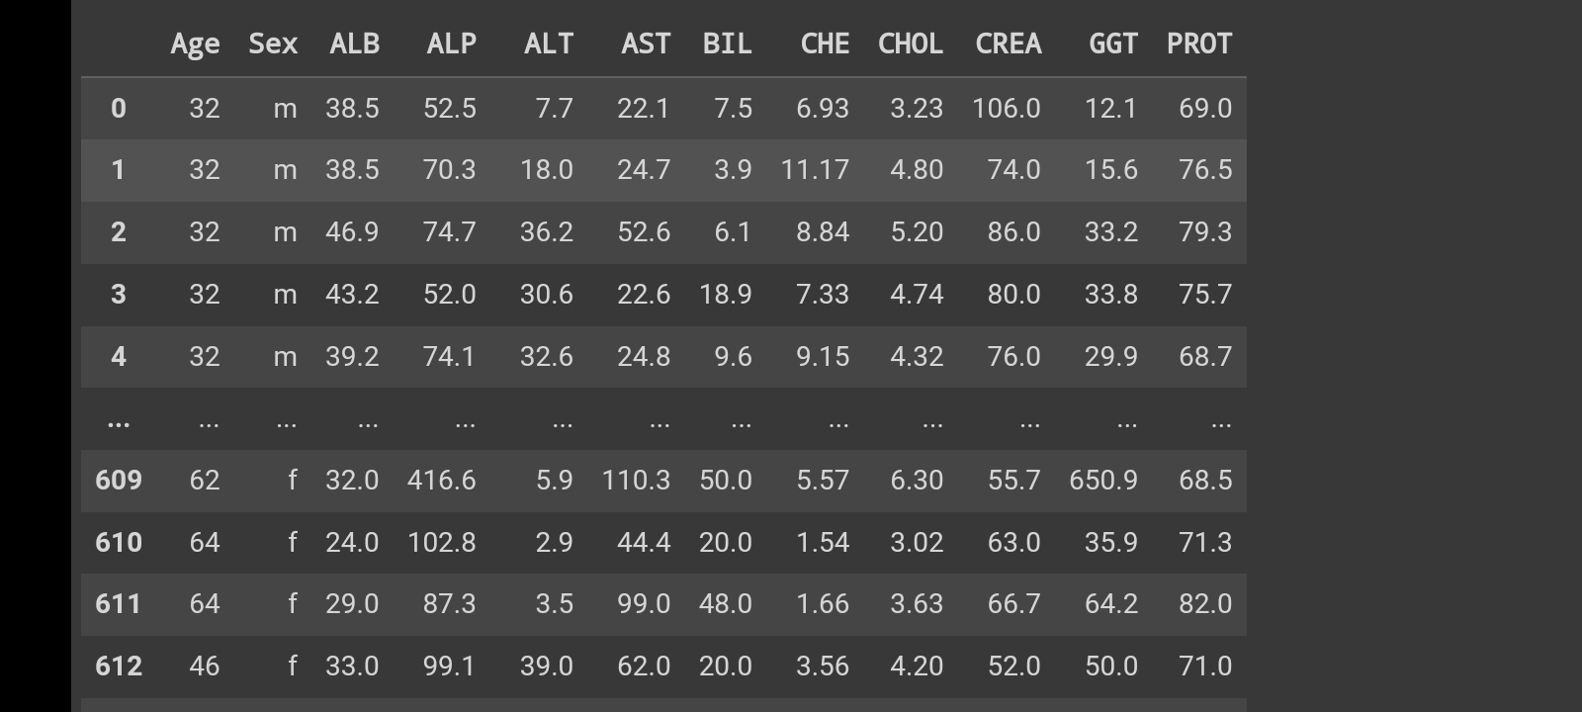

Slide 26
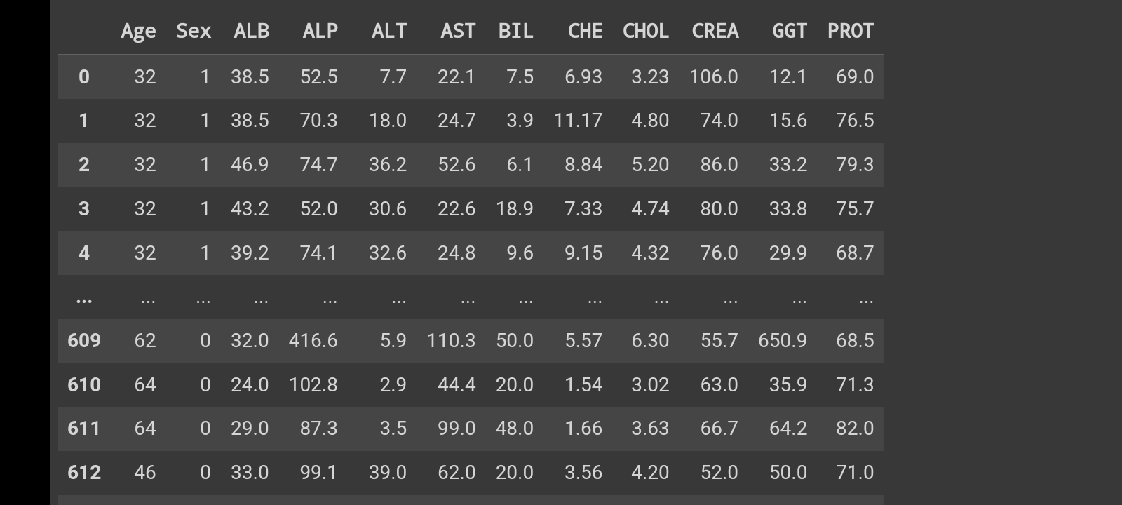

Slide 27
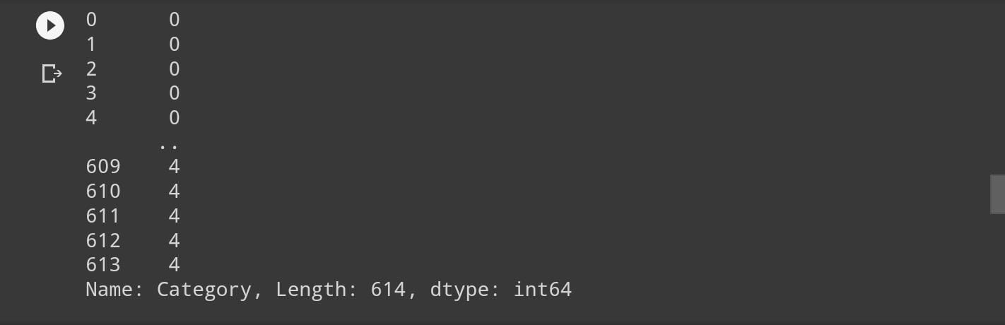

Slide 28
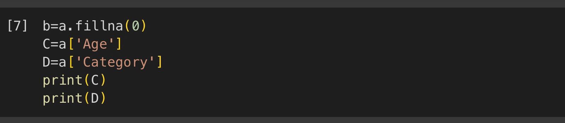
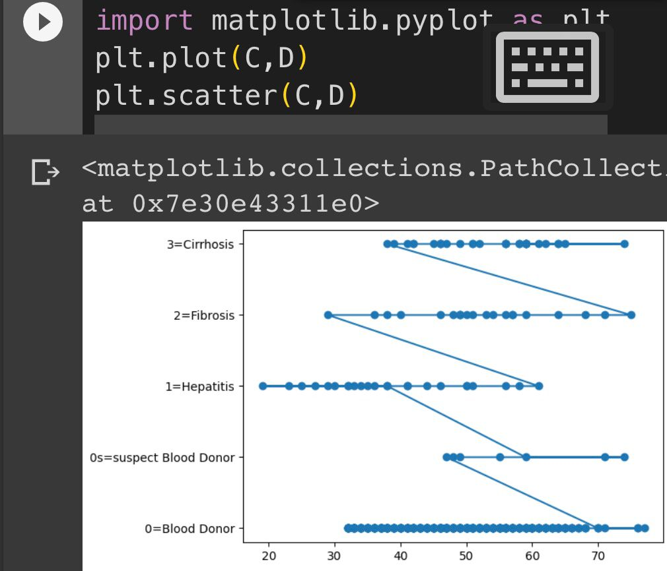
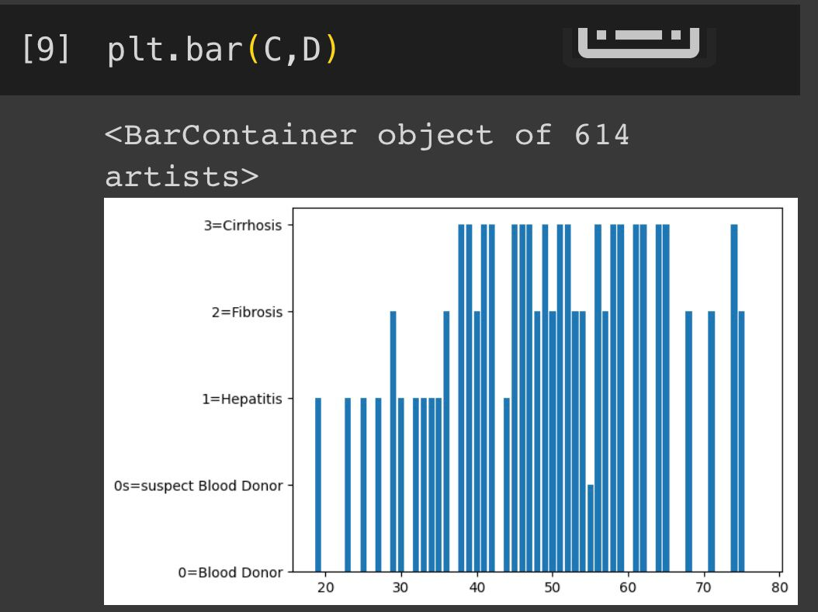

Slide 29
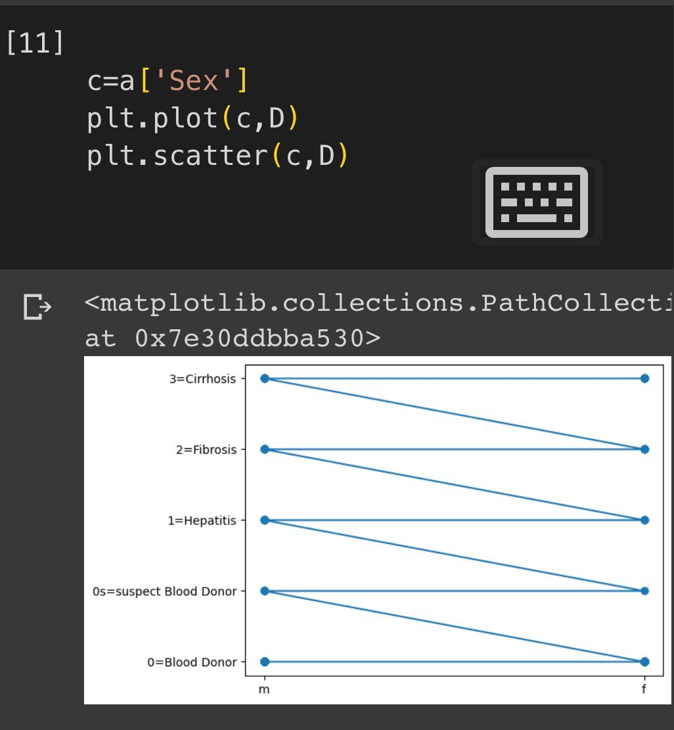
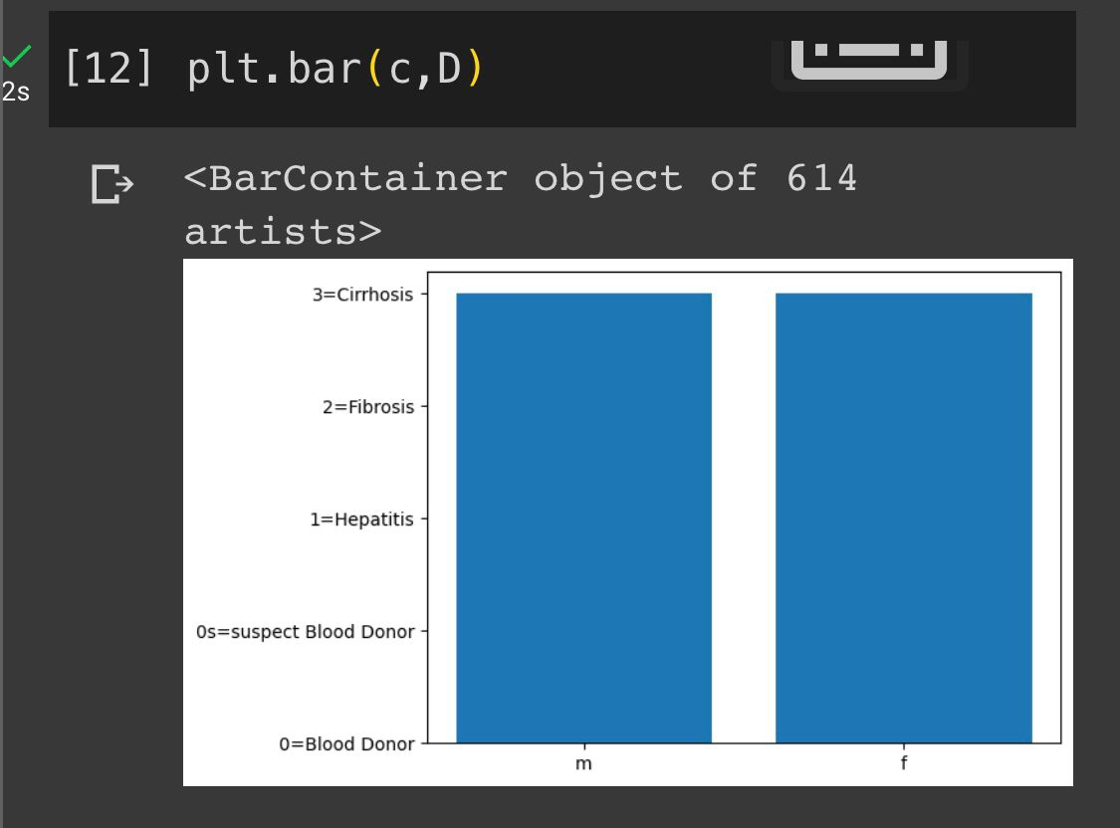

Slide 30
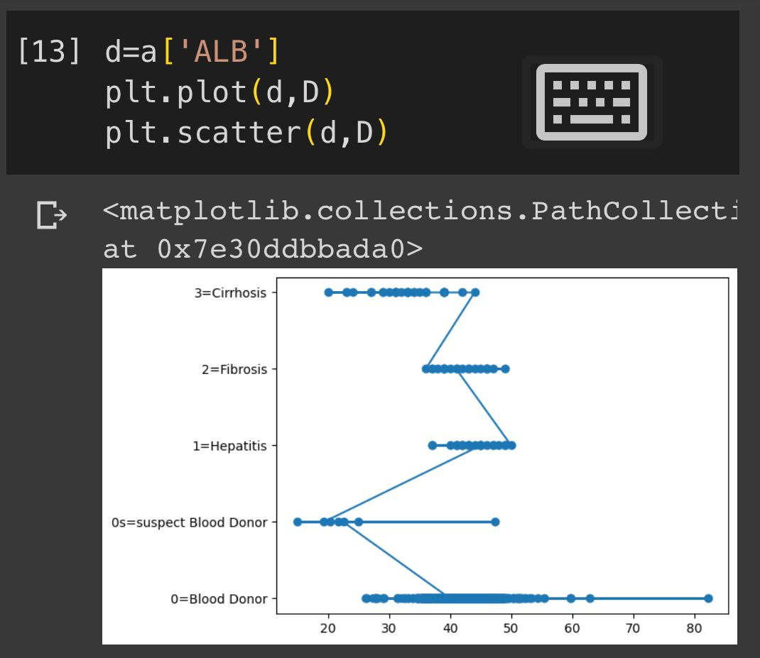
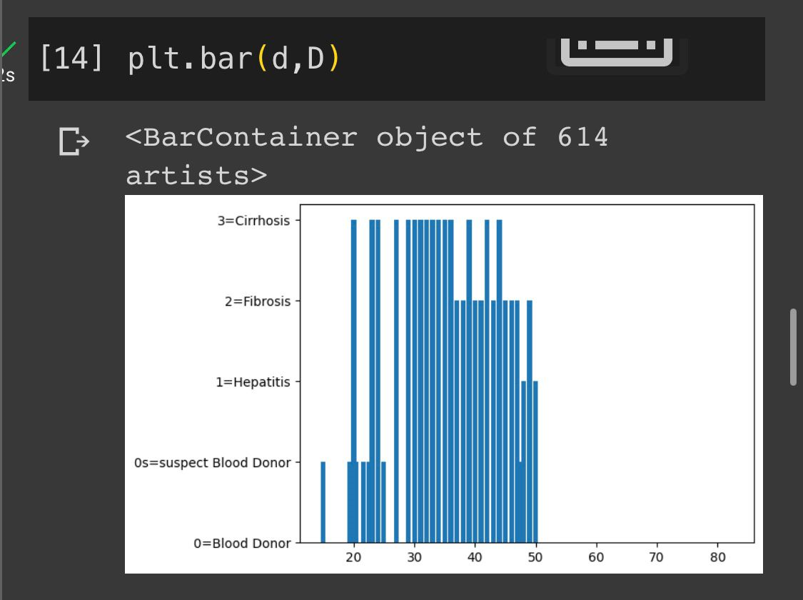

Slide 31
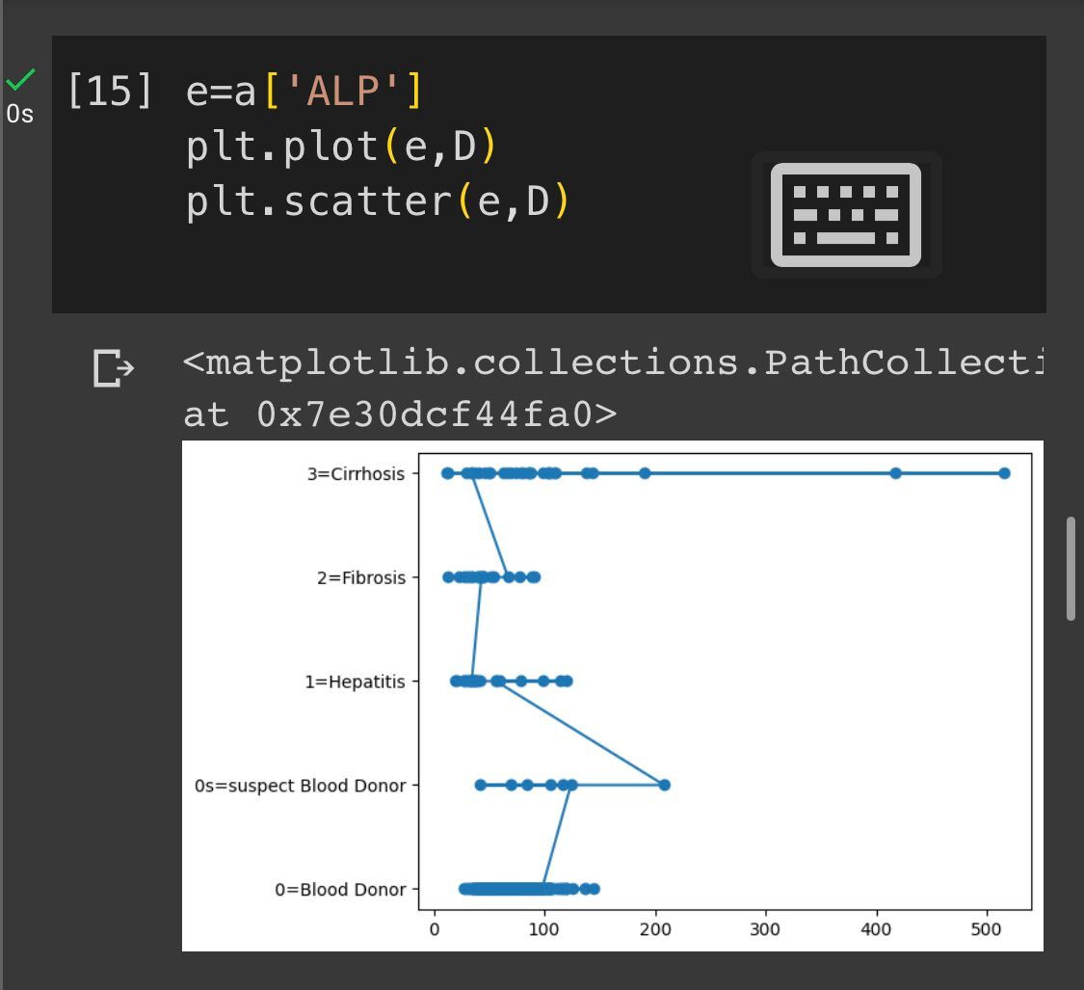
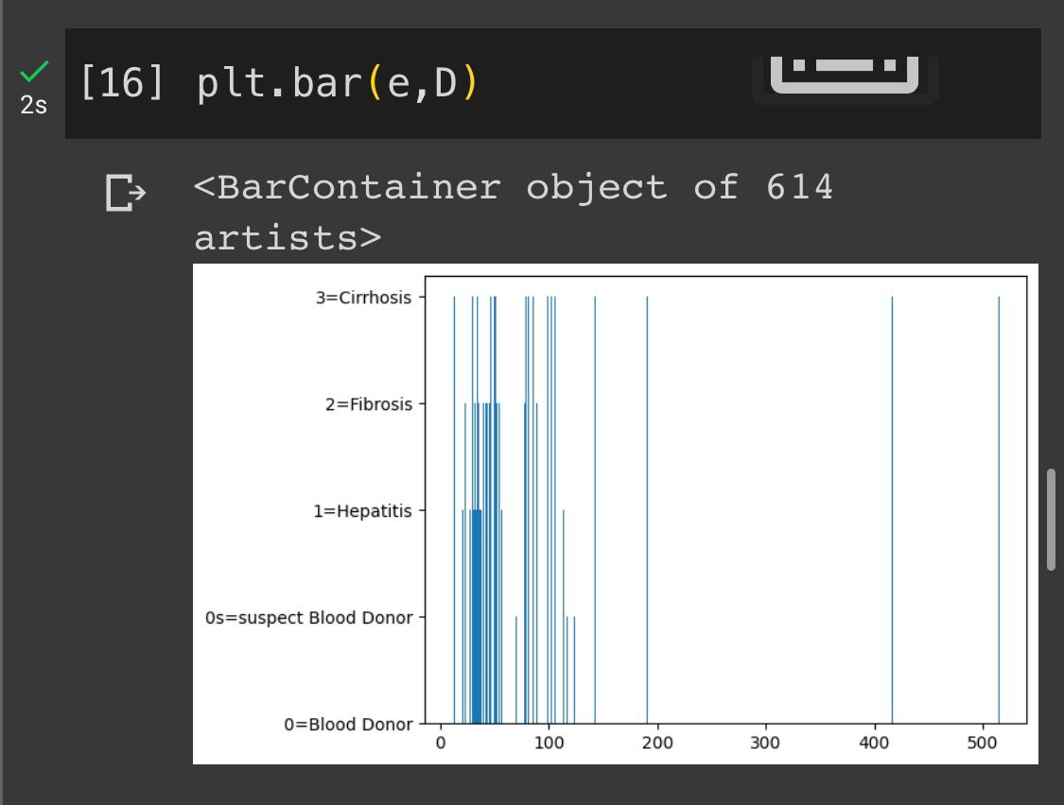

Slide 32
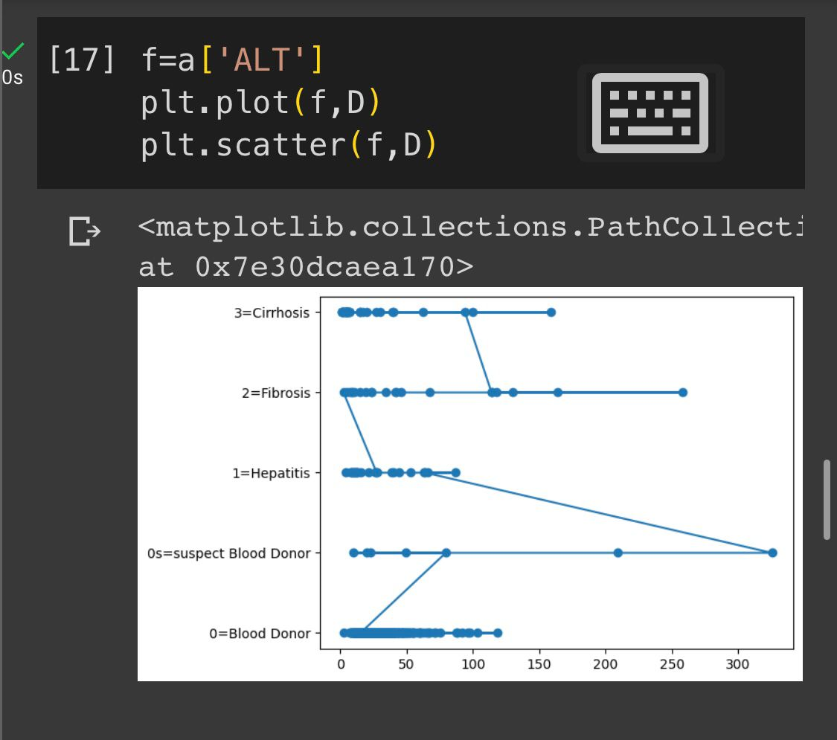
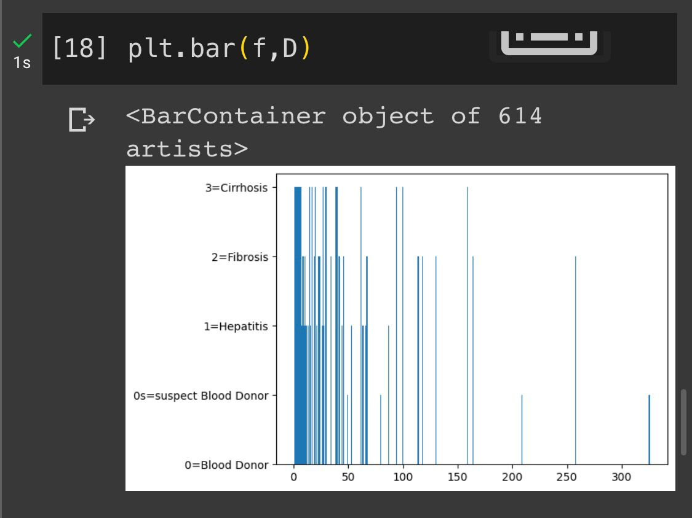

Slide 33
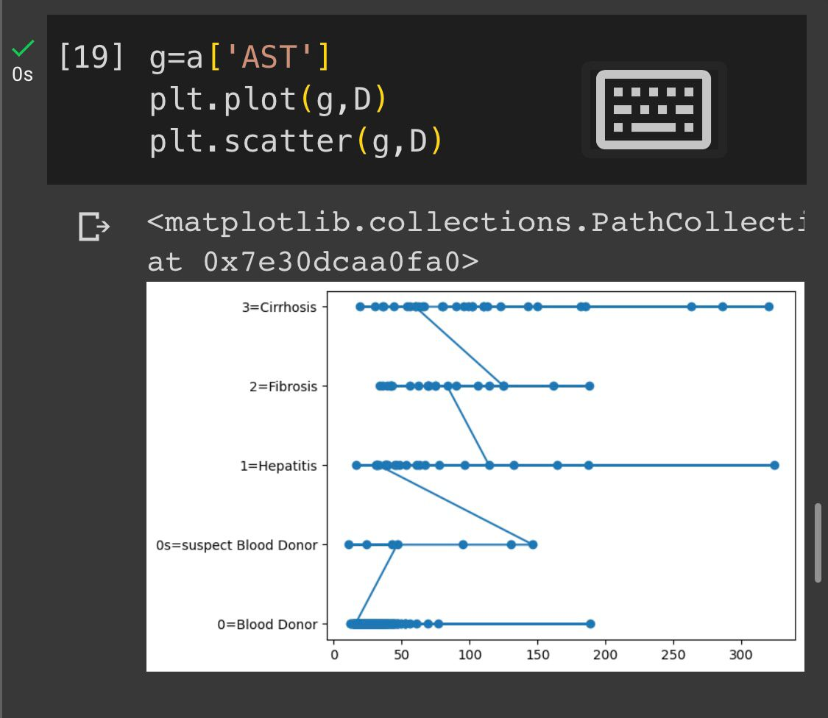
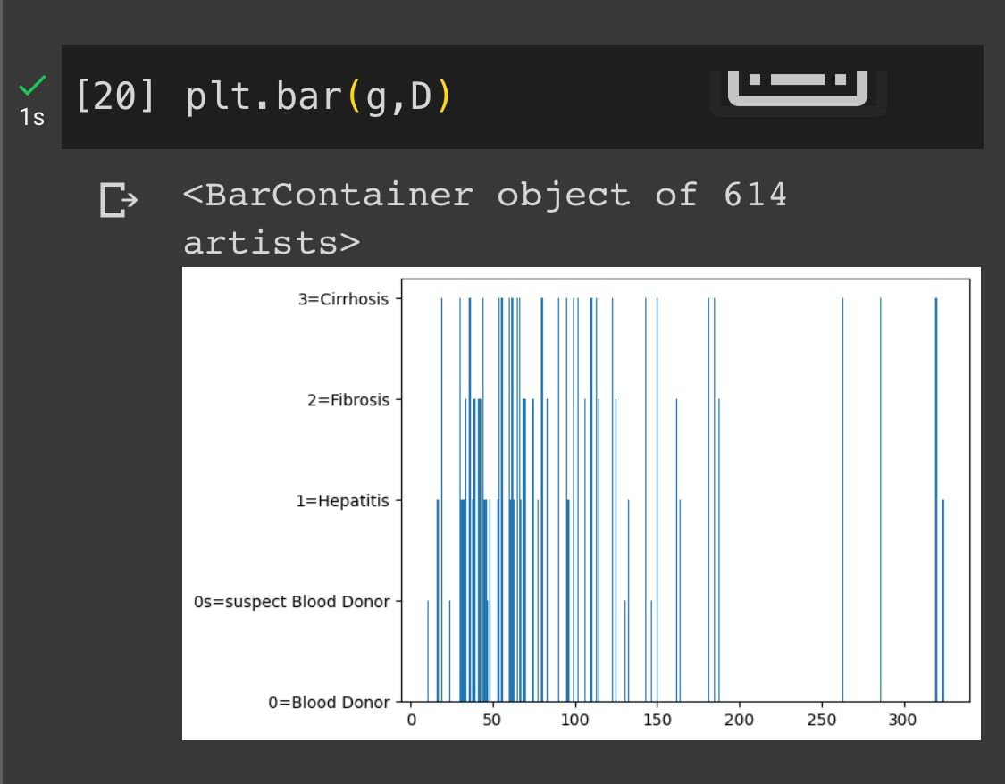

Slide 34
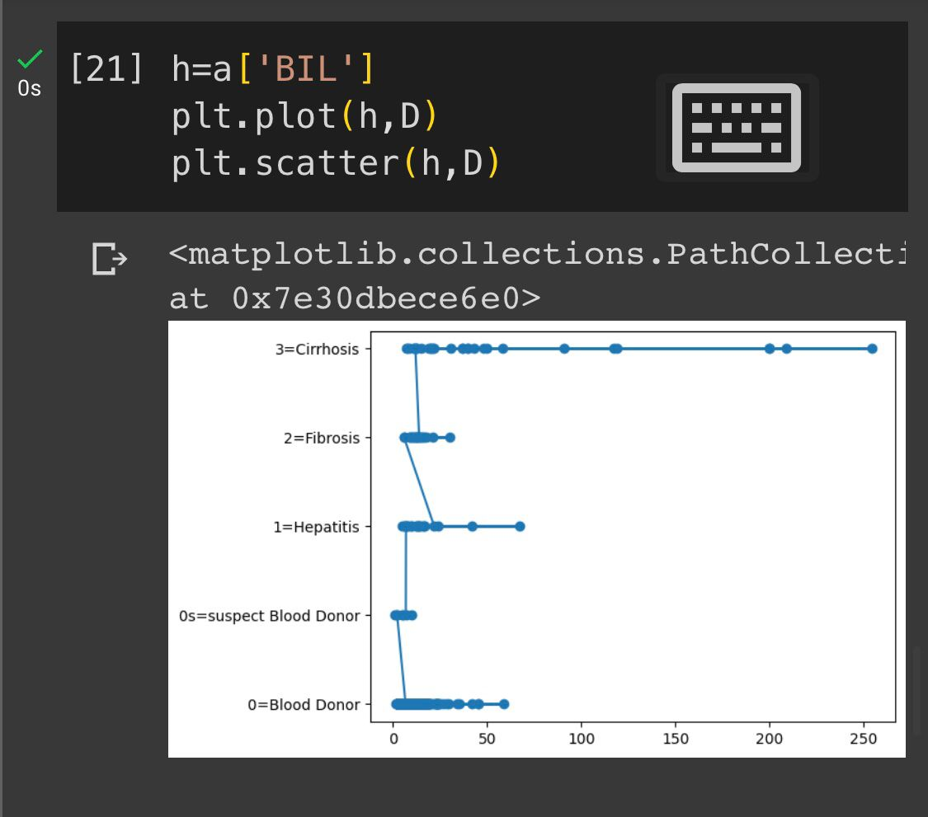
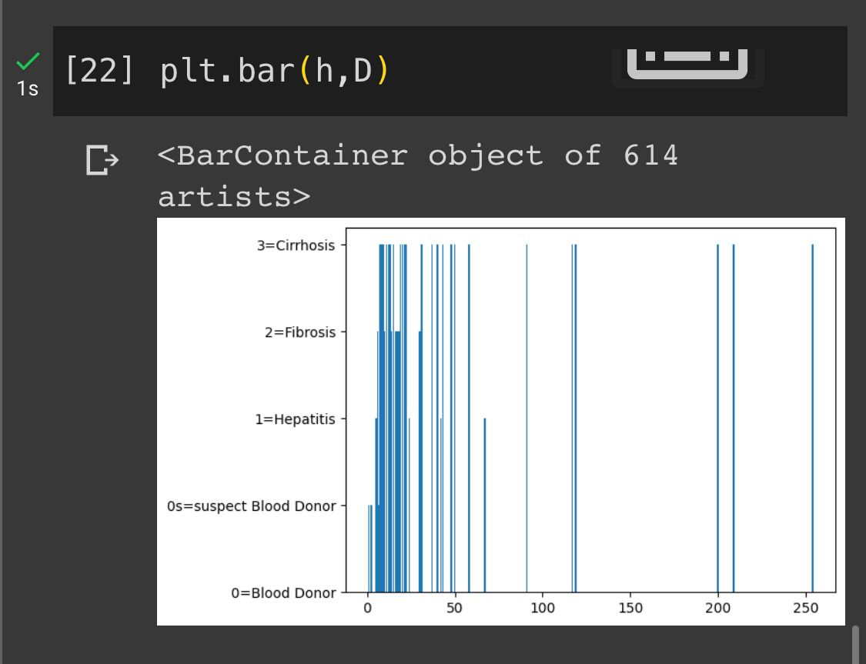

Slide 35
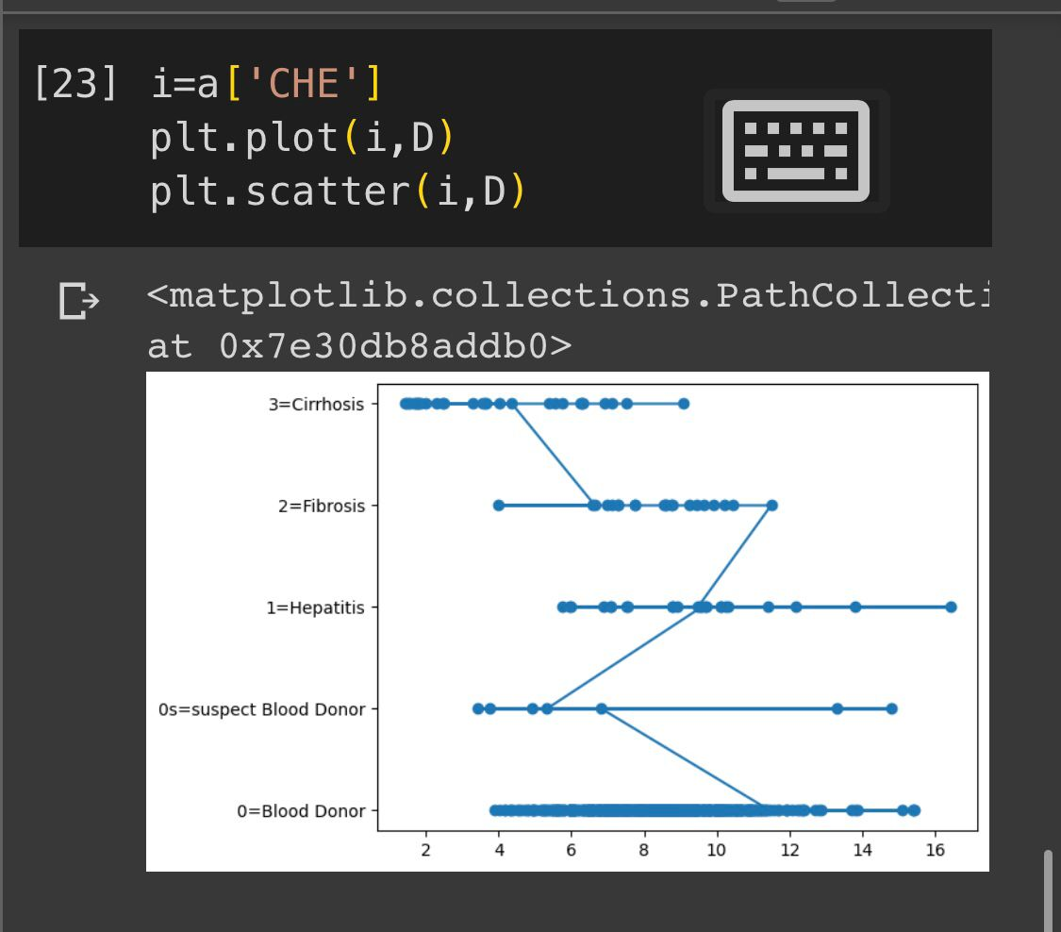
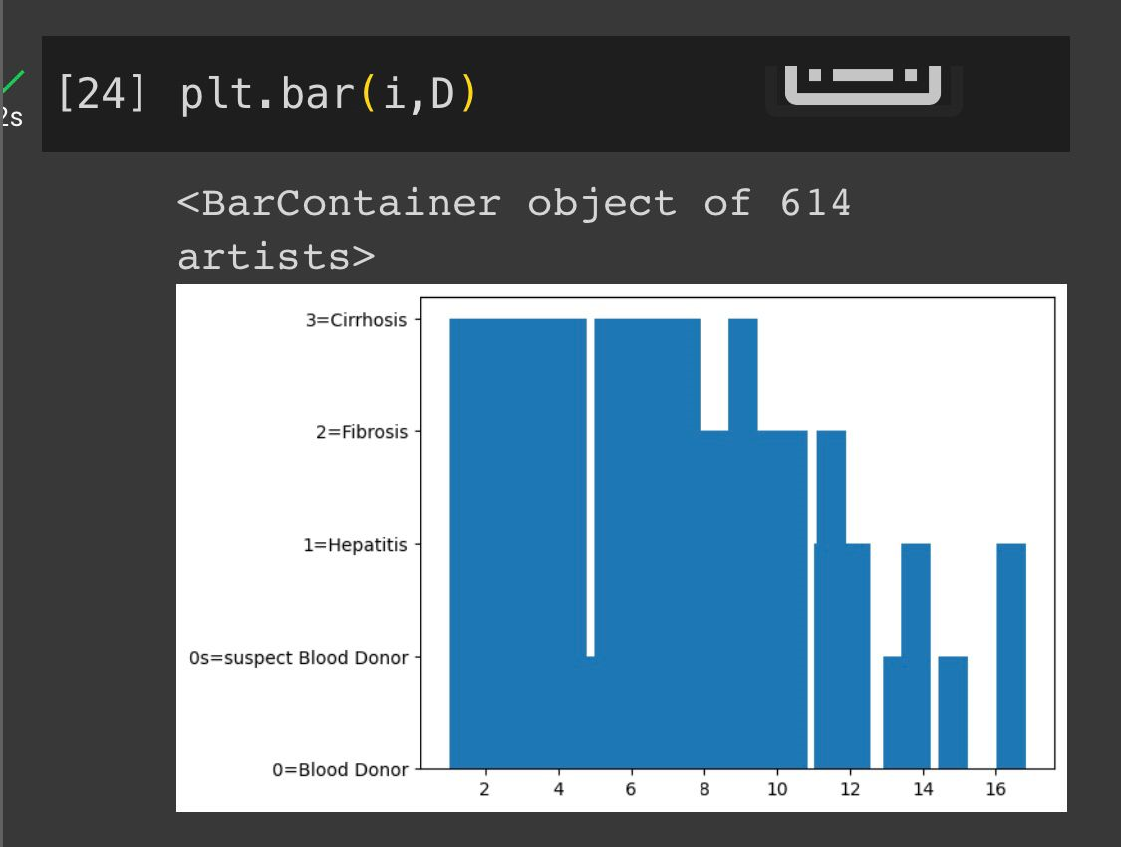

Slide 36
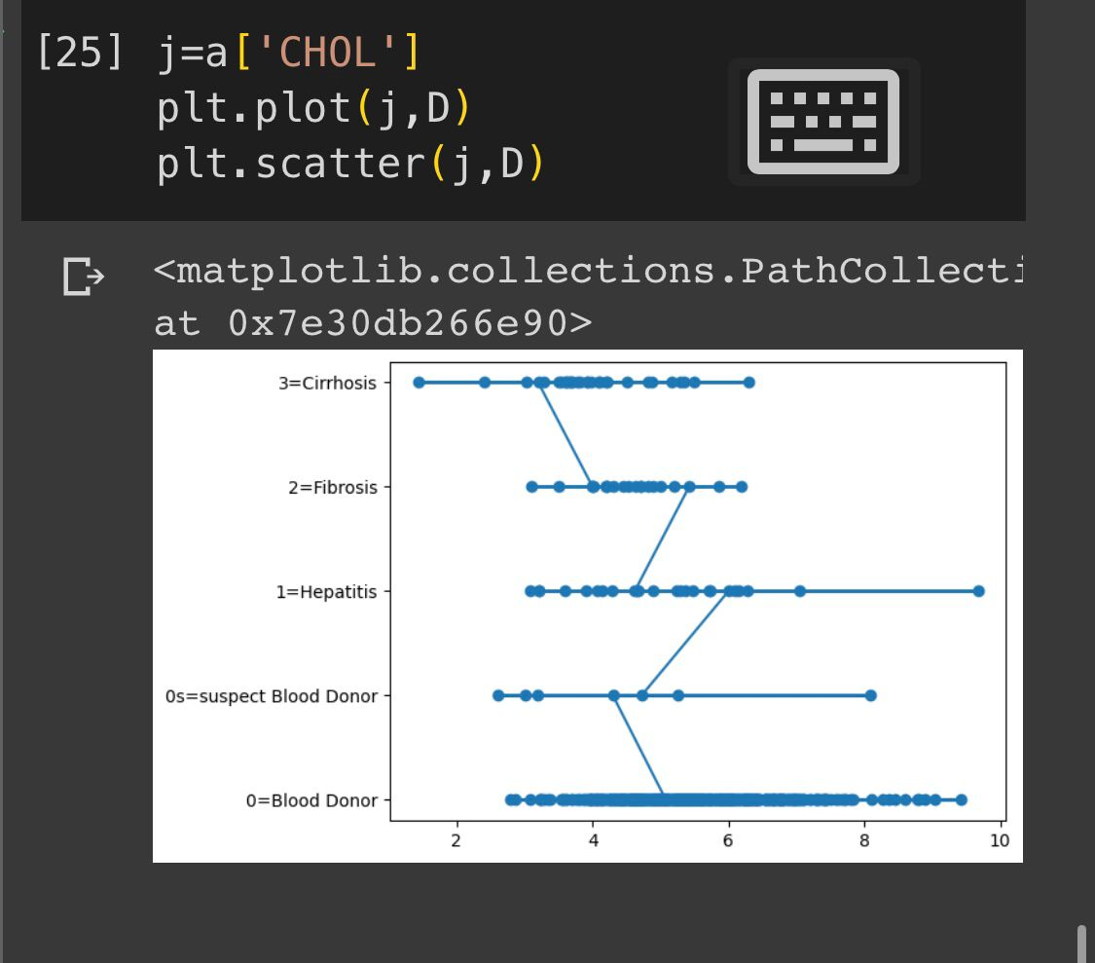
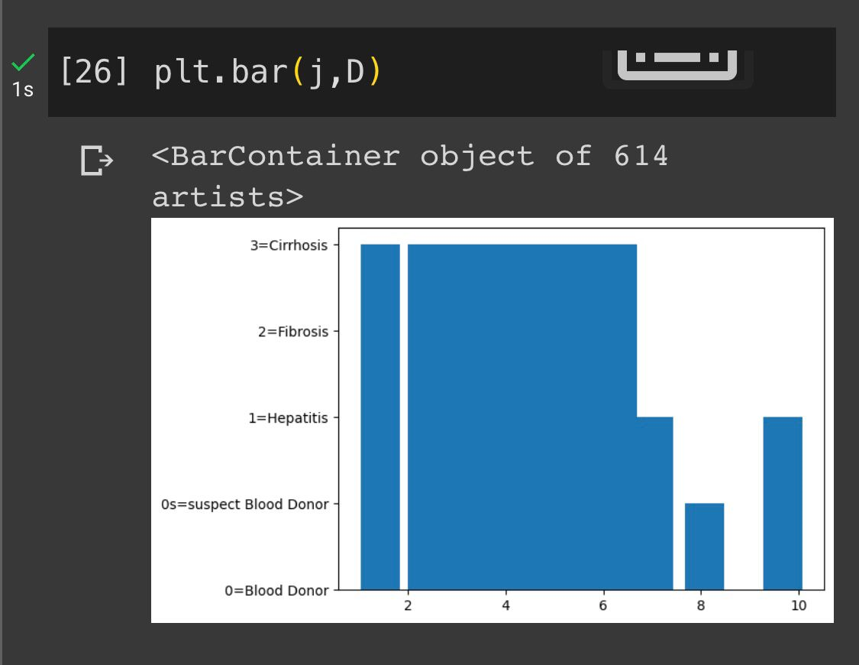

Slide 37
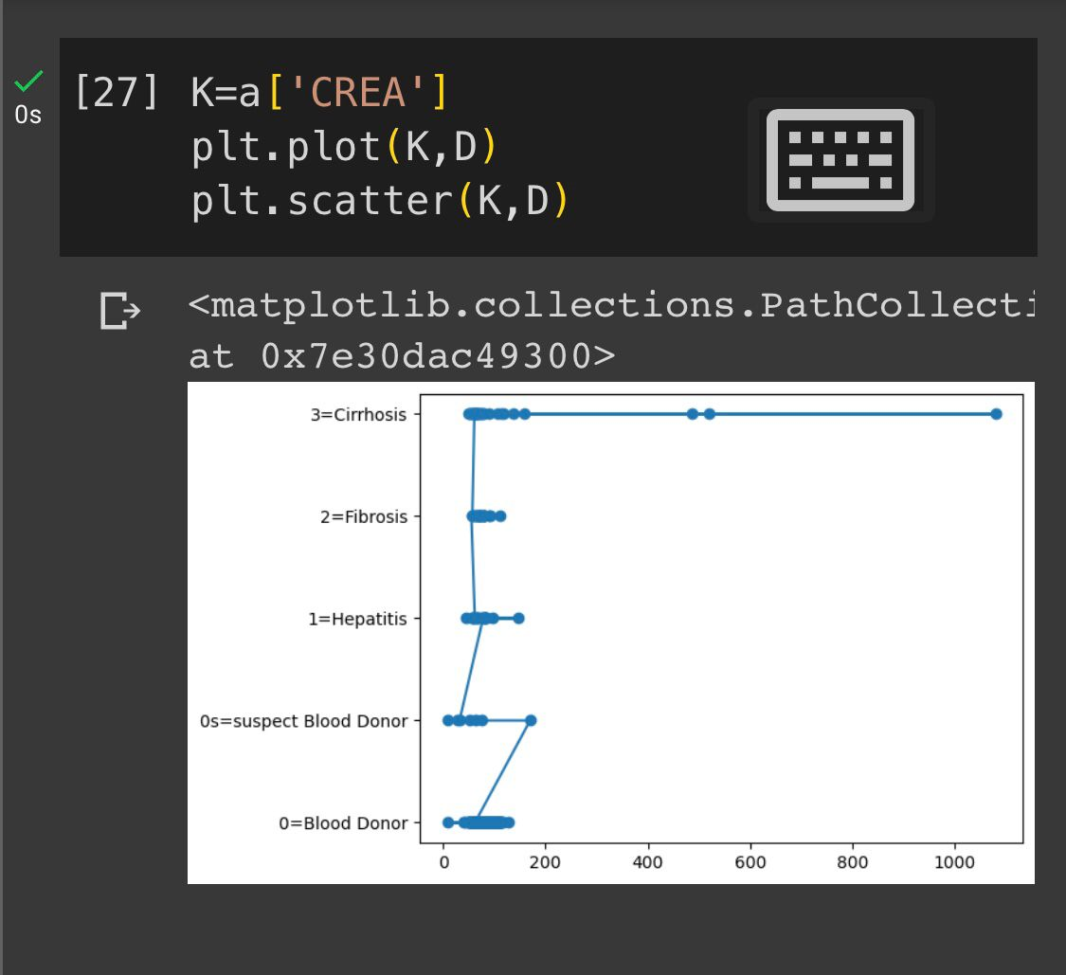
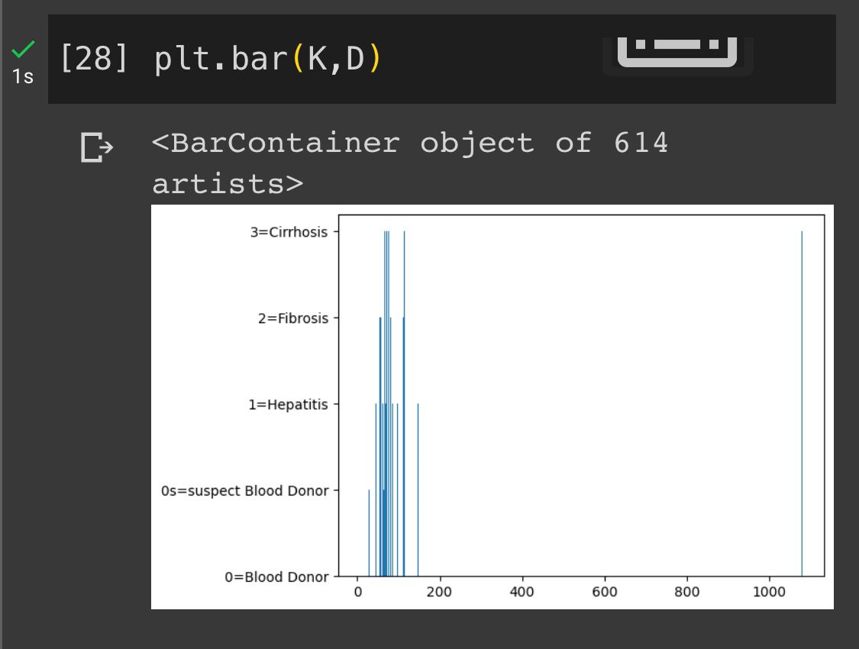

Slide 38
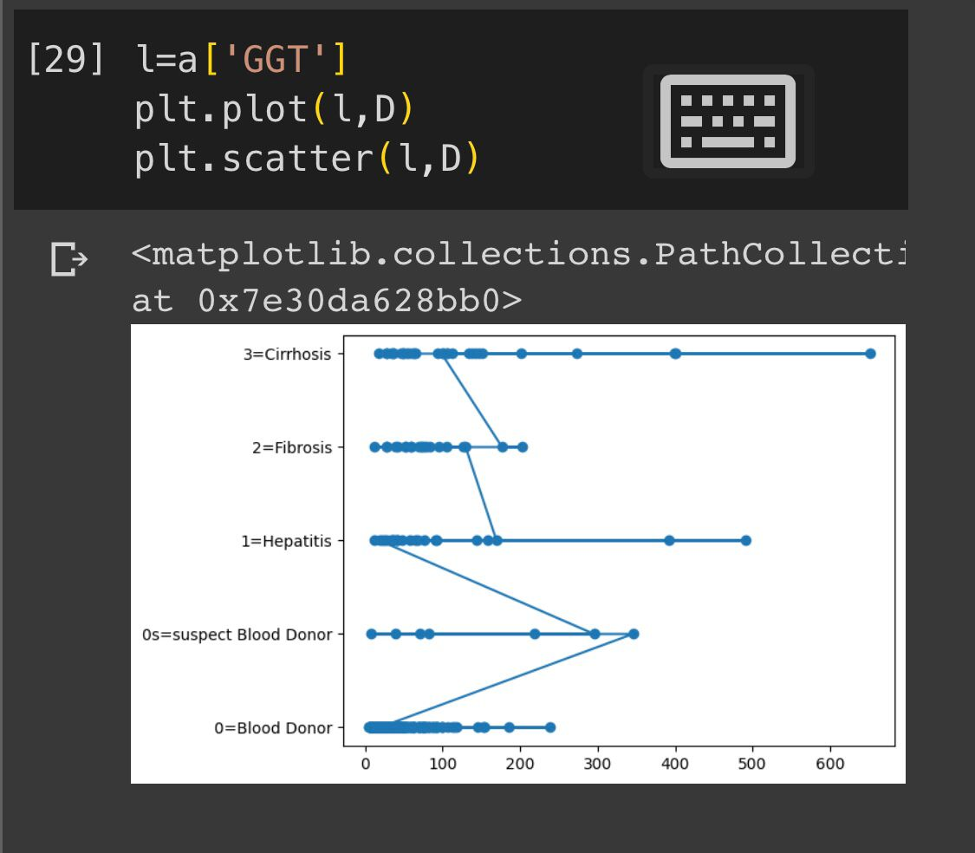
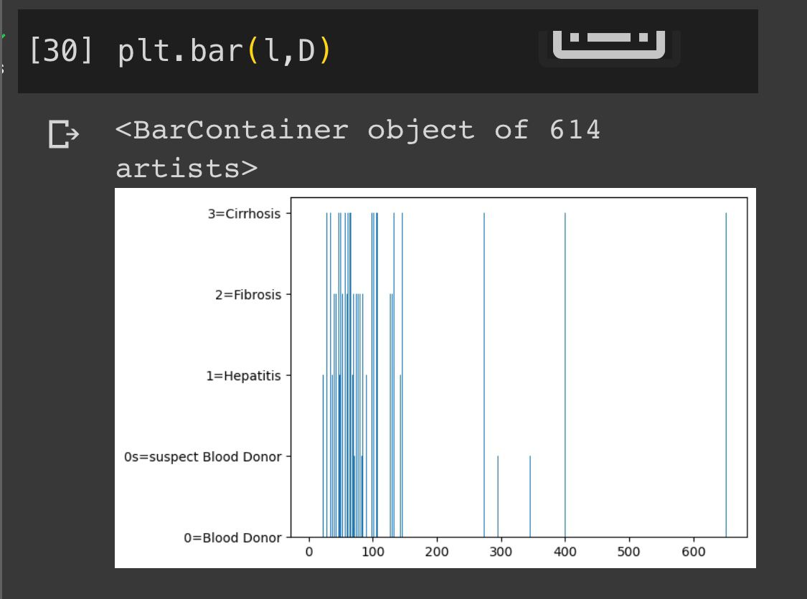

Slide 39
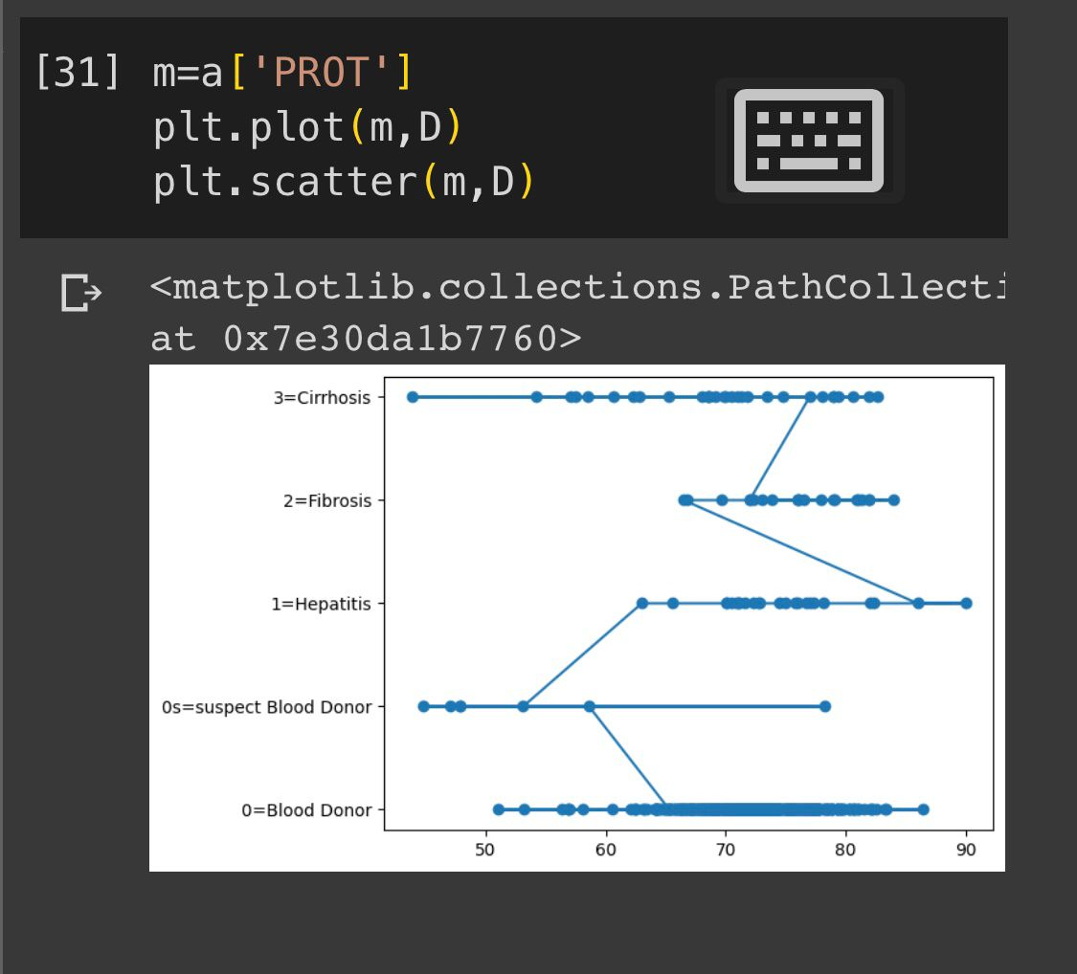
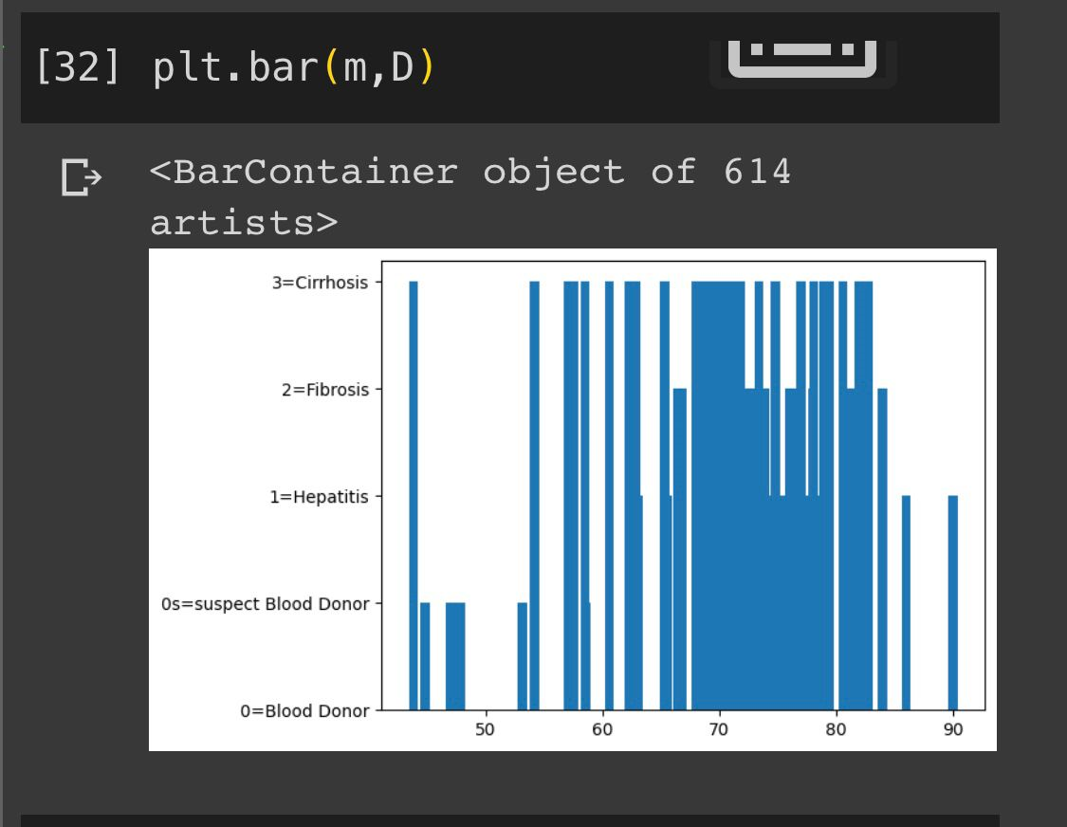

Slide 40
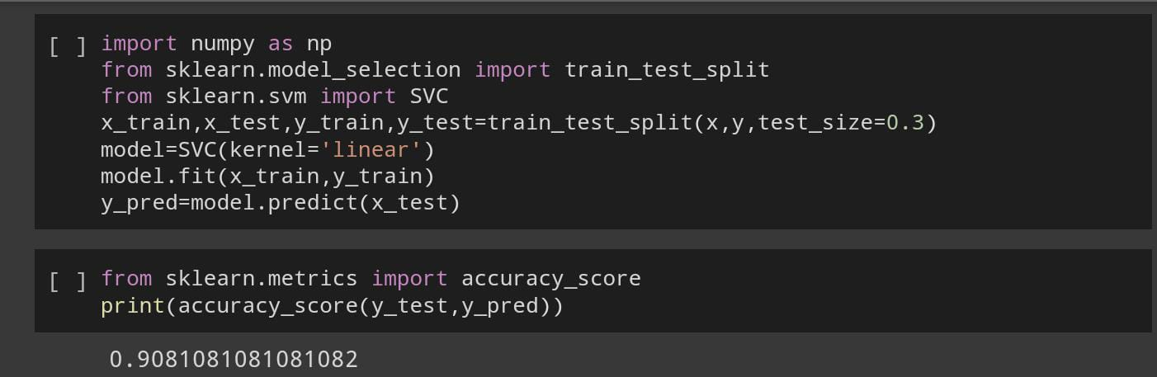

Slide 41
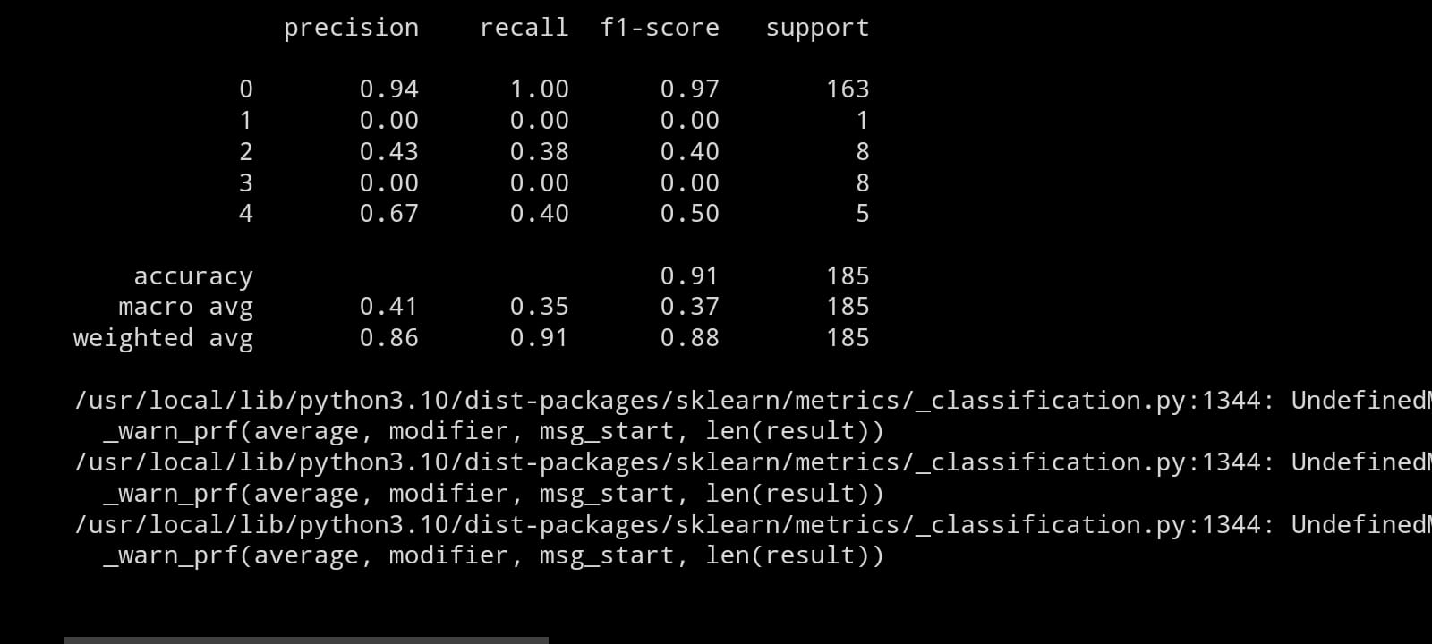

Slide 42
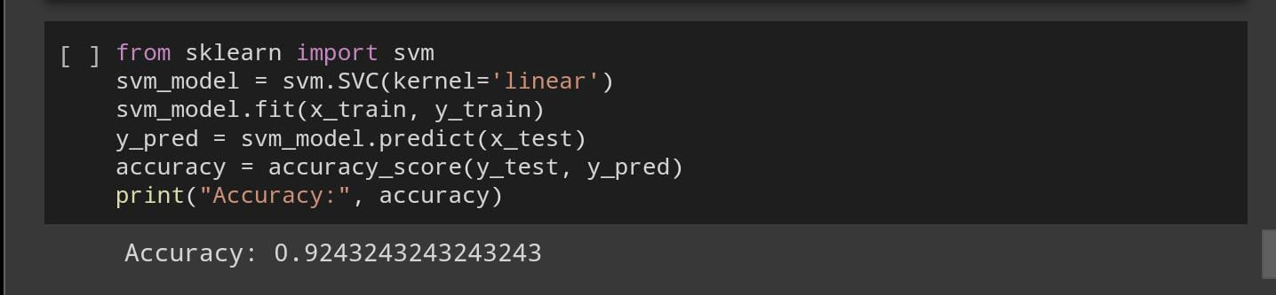

Slide 43
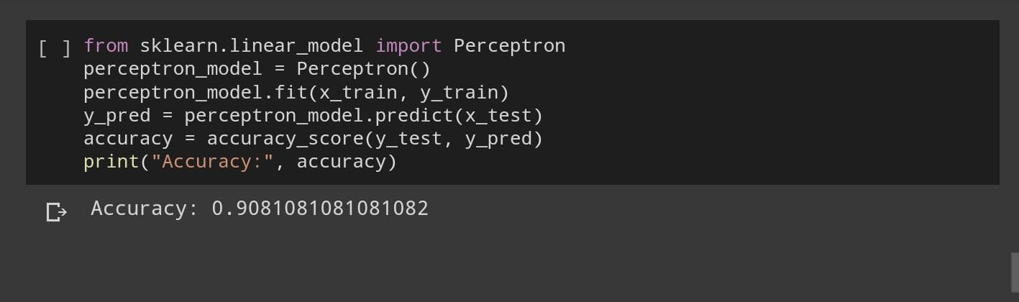

Slide 44
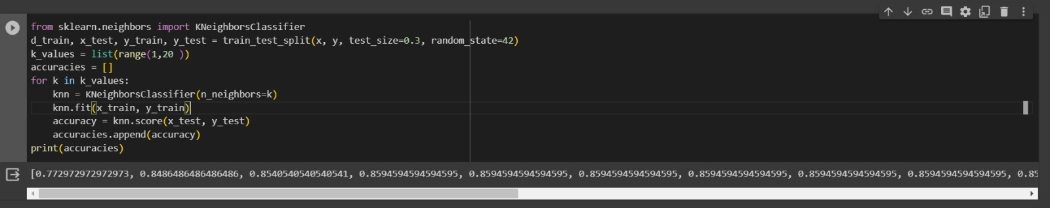

Slide 45
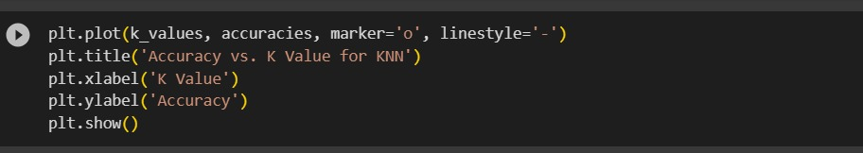
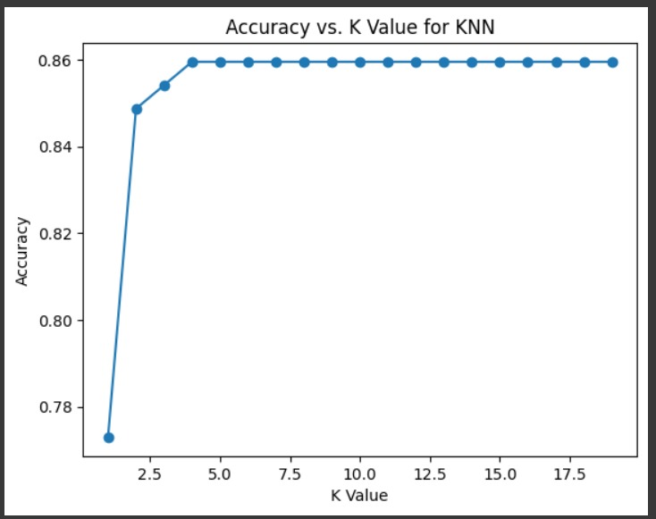

Slide 46
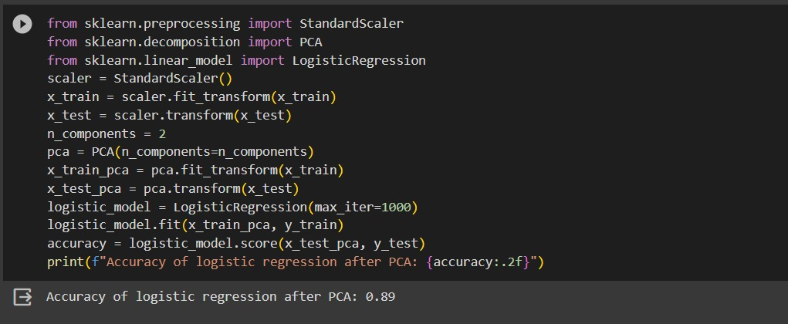
With using PCA
Logistic Regression

Slide 47
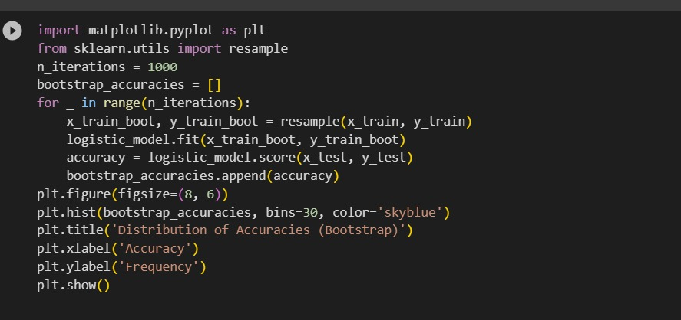
Bootstrapping

Slide 48
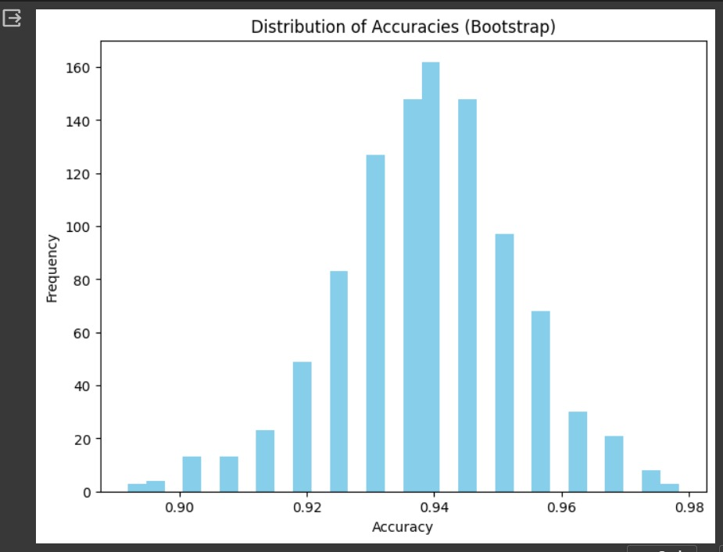

Slide 49
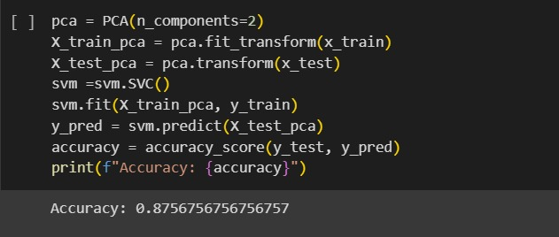
SVM

Slide 50
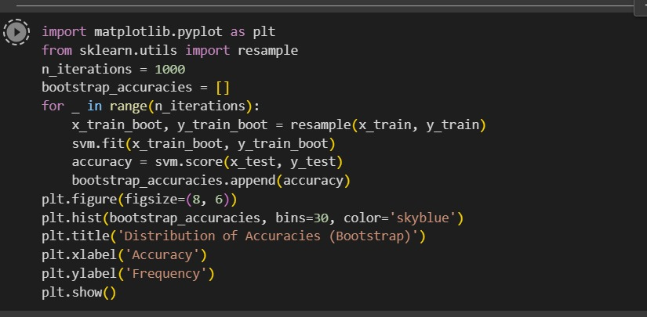
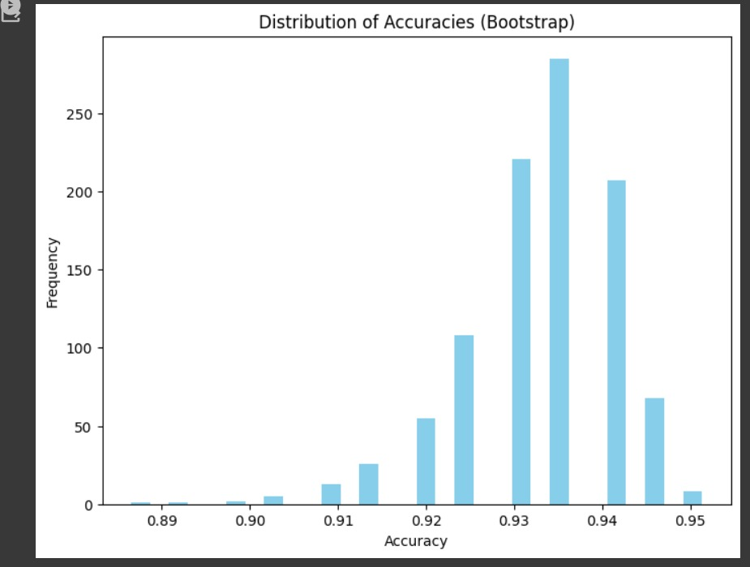

Slide 51
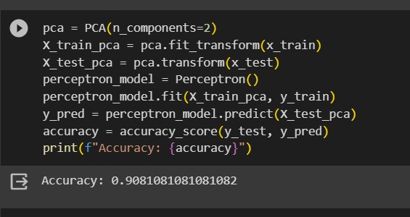
Perceptron

Slide 52
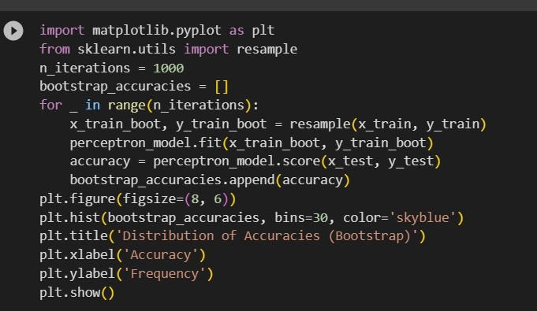
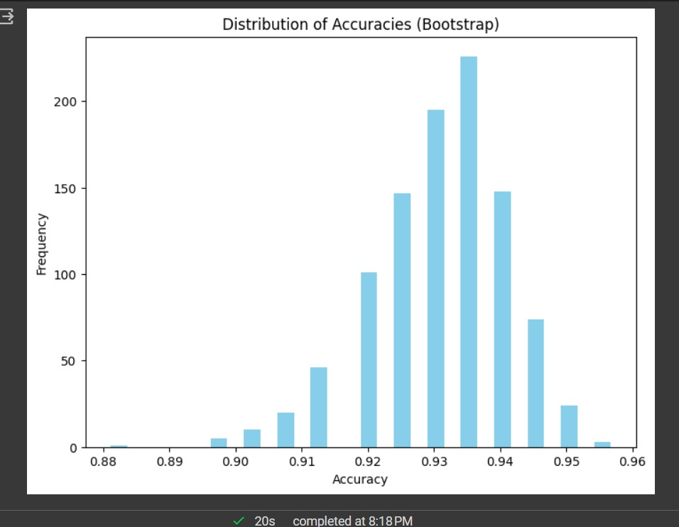

Slide 53
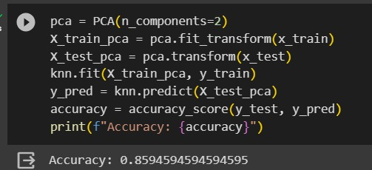
KNN

Slide 54



Slide 55
RESULT ANALYSIS:
Comparison of the results from different sources:
My results:
LOGISTIC REGRESSION:0.9081081081081082
SUPPORT VECTOR MACHINE:0.9243243243242343
PERVEPTRON LEARNING:0.9081081081081082
Source 1:
LOGISTIC REGRESSION:0.9027027027027027
SUPPORT VECTOR MACHINE:0.9027027027027027
PERVEPTRON LEARNING:0.9783783783783784

Slide 56
Source 2:
LOGISTIC REGRESSION:0.972972972972973
SUPPORT VECTOR MACHINE:0.972972972972973
PERVEPTRON LEARNING:0.9243243243243243
Source 3:
LOGISTIC REGRESSION:0.9783783783783784
SUPPORT VECTOR MACHINE:0.9783783783783784
PERVEPTRON LEARNING:0.8540540540540541

Slide 57
Source 4:
LOGISTIC REGRESSION:0.9621621621621622
SUPPORT VECTOR MACHINE:0.9621621621621622
PERVEPTRON LEARNING:0.8864864864864865
Source 5:
LOGISTIC REGRESSION:0.89
SUPPORT VECTOR MACHINE:0.8756756756756757
PERVEPTRON LEARNING:0.9081081081082

Slide 58
CONCLUSION:
The Accuracies obtained without PCA are:
LOGISTIC REGRESSION:0.9081081081081082
SUPPORT VECTOR MACHINE:0.9243243243242343
PERVEPTRON LEARNING:0.9081081081081082
The Accuracies obtained with PCA are:
LOGISTIC REGRESSION:0.89
SUPPORT VECTOR MACHINE:0.9243243243242343
PERVEPTRON LEARNING:0.9081081081081082

Slide 59
GITHUB LINK:
https://github.com/2203A52210/project2

